Slide 1
Electrocution of Raptors
www.schoollinksprogramme.org

Slide 2
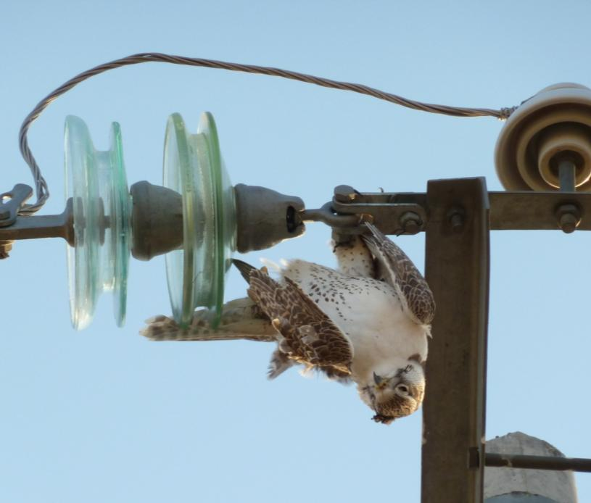
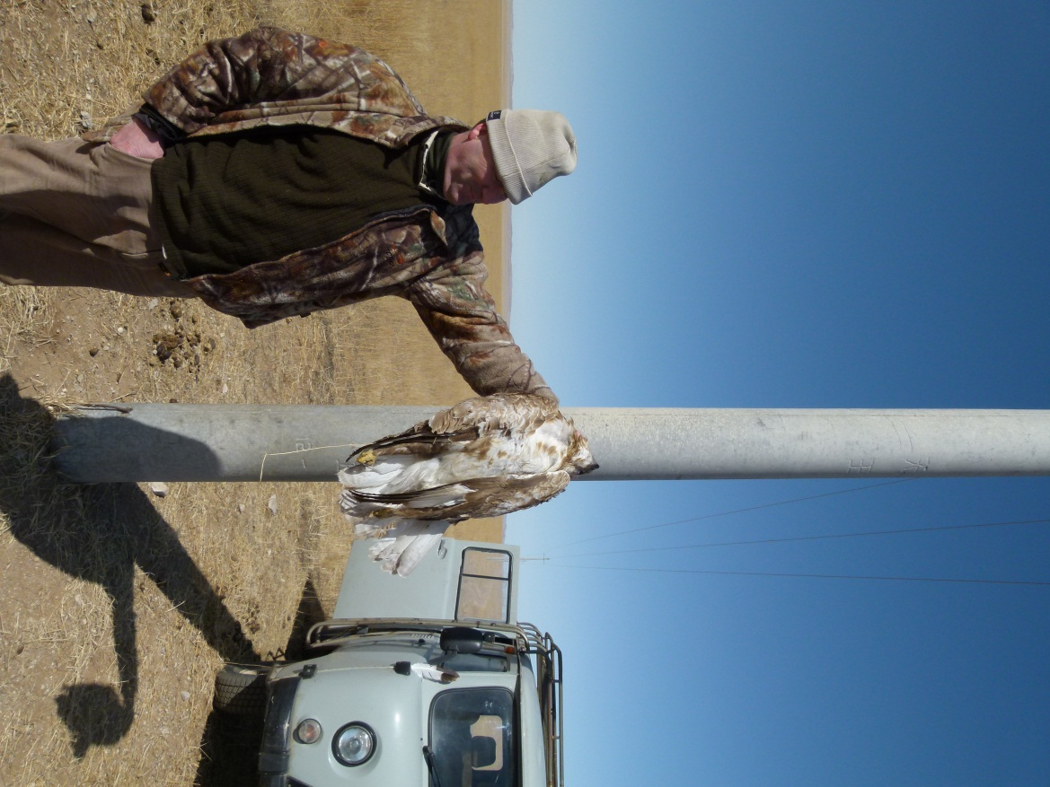
Raptor Mortality
Thousands of raptors are electrocuted on poorly insulated and badly designed power lines and poles each year
Electrocution on power lines is a major cause of death for Mongolian Saker Falcons

Slide 3
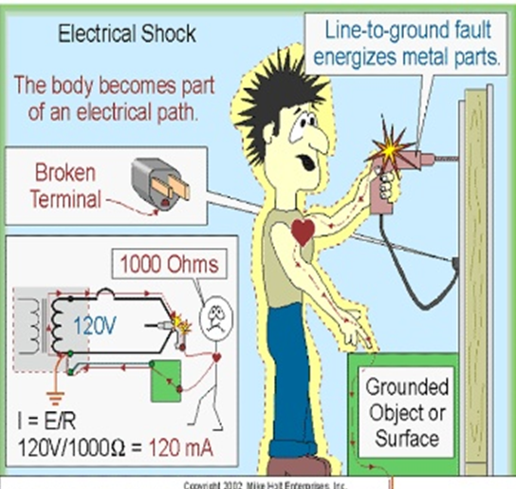
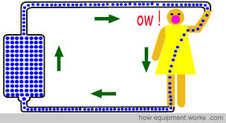
Electric shock
If you touch a live uninsulated wire or object, you sometimes feel a shock.
This is actually the electrons travelling from the object through your body and into the ground.
Electric shock occurs when the body becomes part of an electric circuit
Electric current enters the body at one point and leaves at another

Slide 4
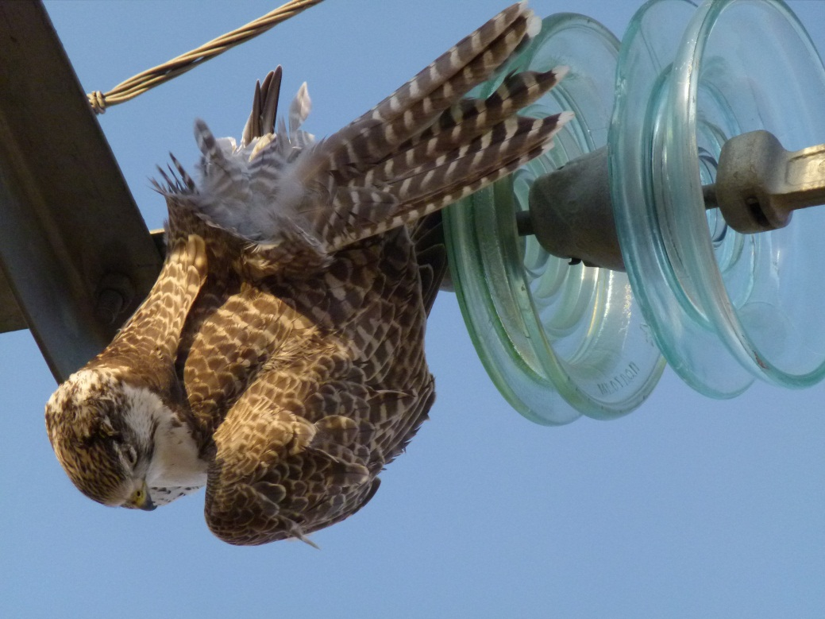
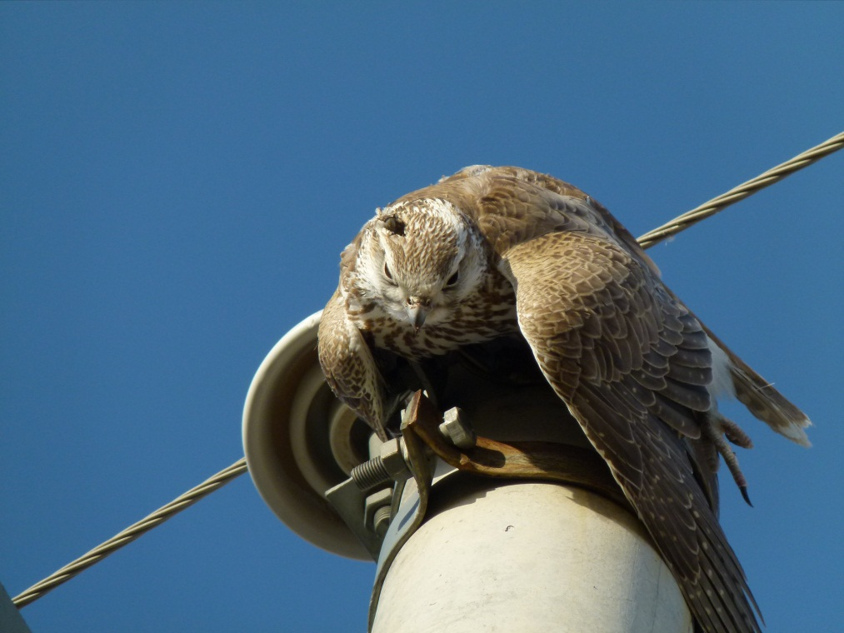
Electrocution
A severe electric shock can cause the heart to stop
If the electric voltage is high the body can be literally cooked and can sometimes explode
Death by electric shock is called ELECTROCUTION

Slide 5
Electricity Conductors
To understand how raptors are electrocuted on power lines, you need to know about CONDUCTORS & INSULATORS
CONDUCTORS of Electricity
Substances which allow electricity to pass through them are called conductors.
Silver, Gold, Copper, Aluminium, Platinum, Water,
People and Animals &Trees
Electricity will always take the shortest path to the ground. Your body is 60% water and that makes you a good conductor of electricity.
If a power line has fallen on a tree and you touch the tree you become the path or conductor to the ground and could get electrocuted.

Slide 6
Electricity Insulators
INSULATORS of Electricity
Substances which do not allow electricity to pass through them are called insulators.
Such as plastic, rubber, Glass, Porcelain, Plastic & Rubber
The rubber or plastic on an electrical cord provides an insulator for the wires.
By covering the wires, the electricity cannot go through the rubber and is forced to follow the path on the aluminium or copper wires

Slide 7
Transmission power lines
Insulators used for high-voltage power transmission are made from glass or porcelain and are covered with a smooth glaze to shed water
Transmission lines are safe for birds because they are well insulated

Slide 8
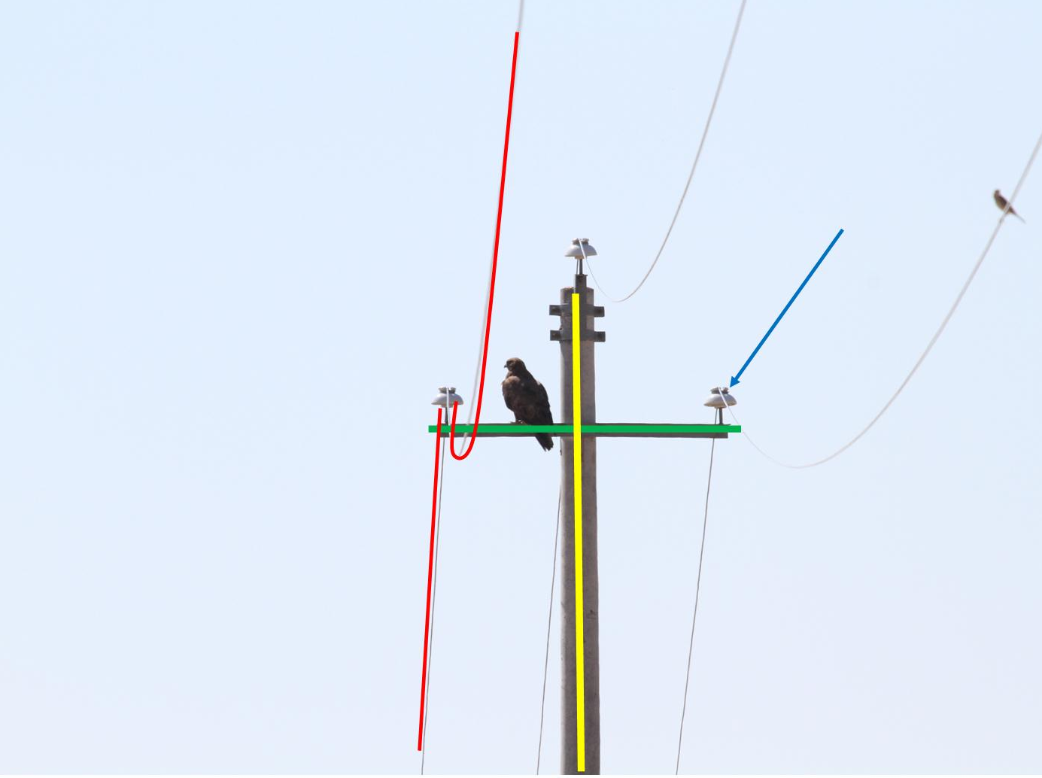
Distribution power lines
This is an insulation pin made of porcelain. This stops the electrified wire cable touching the METAL cross arm
Electricity travels along the wire cables
This cross arm is METAL.
Distribution lines can kill birds if they are poorly insulated
The pole is made of CONCRETE with a METAL core

Slide 9
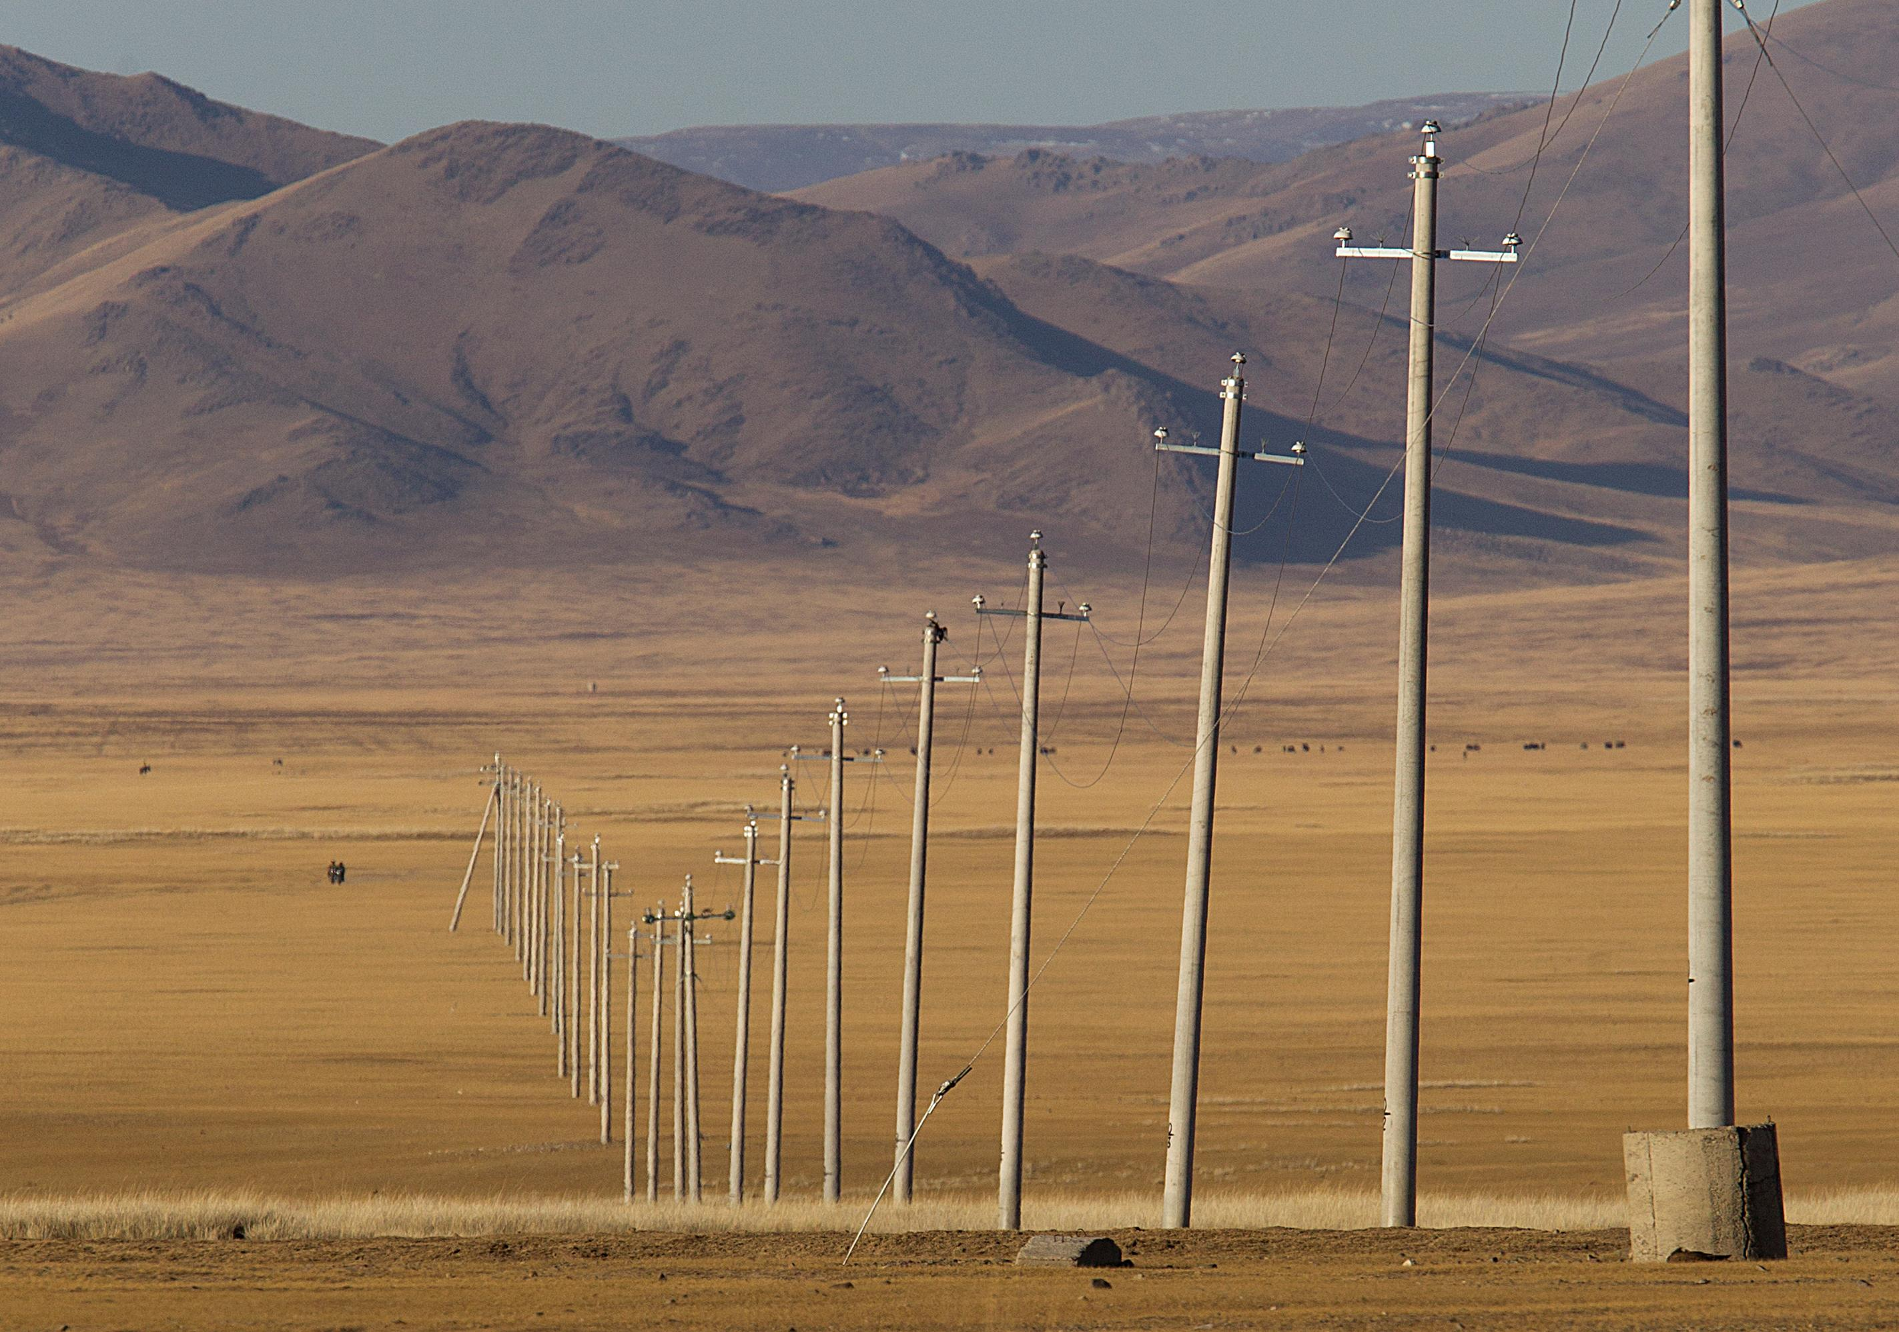
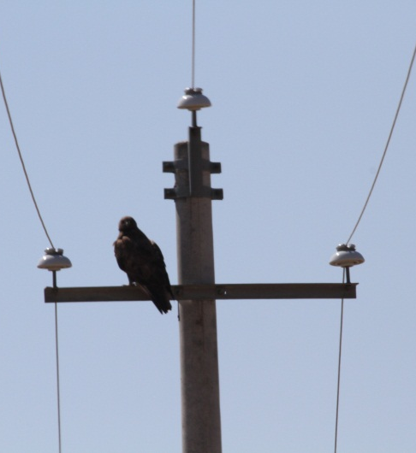
Why do raptors perch on poles?
Many birds, especially raptors, use electricity poles to perch on
This gives the bird a good vantage point for hunting
This mainly happens in open habitat where there are few or no trees
Raptors perch on poles while migrating
Many distribution poles are poorly insulated in Asian and African countries

Slide 10
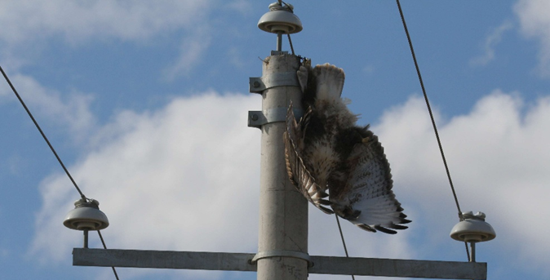
How are raptors electrocuted?
Electrocution occurs when a raptor perches on the metal cross arm and touches a live wire with its wing
The metal cross arm is a good conductor of electricity. The bird is killed instantly
Raptors like to perch on top of the poles. This one was electrocuted when it touched the live wire with its wing
Electrocution occurs when a raptor touches two wires at the same time

Slide 11
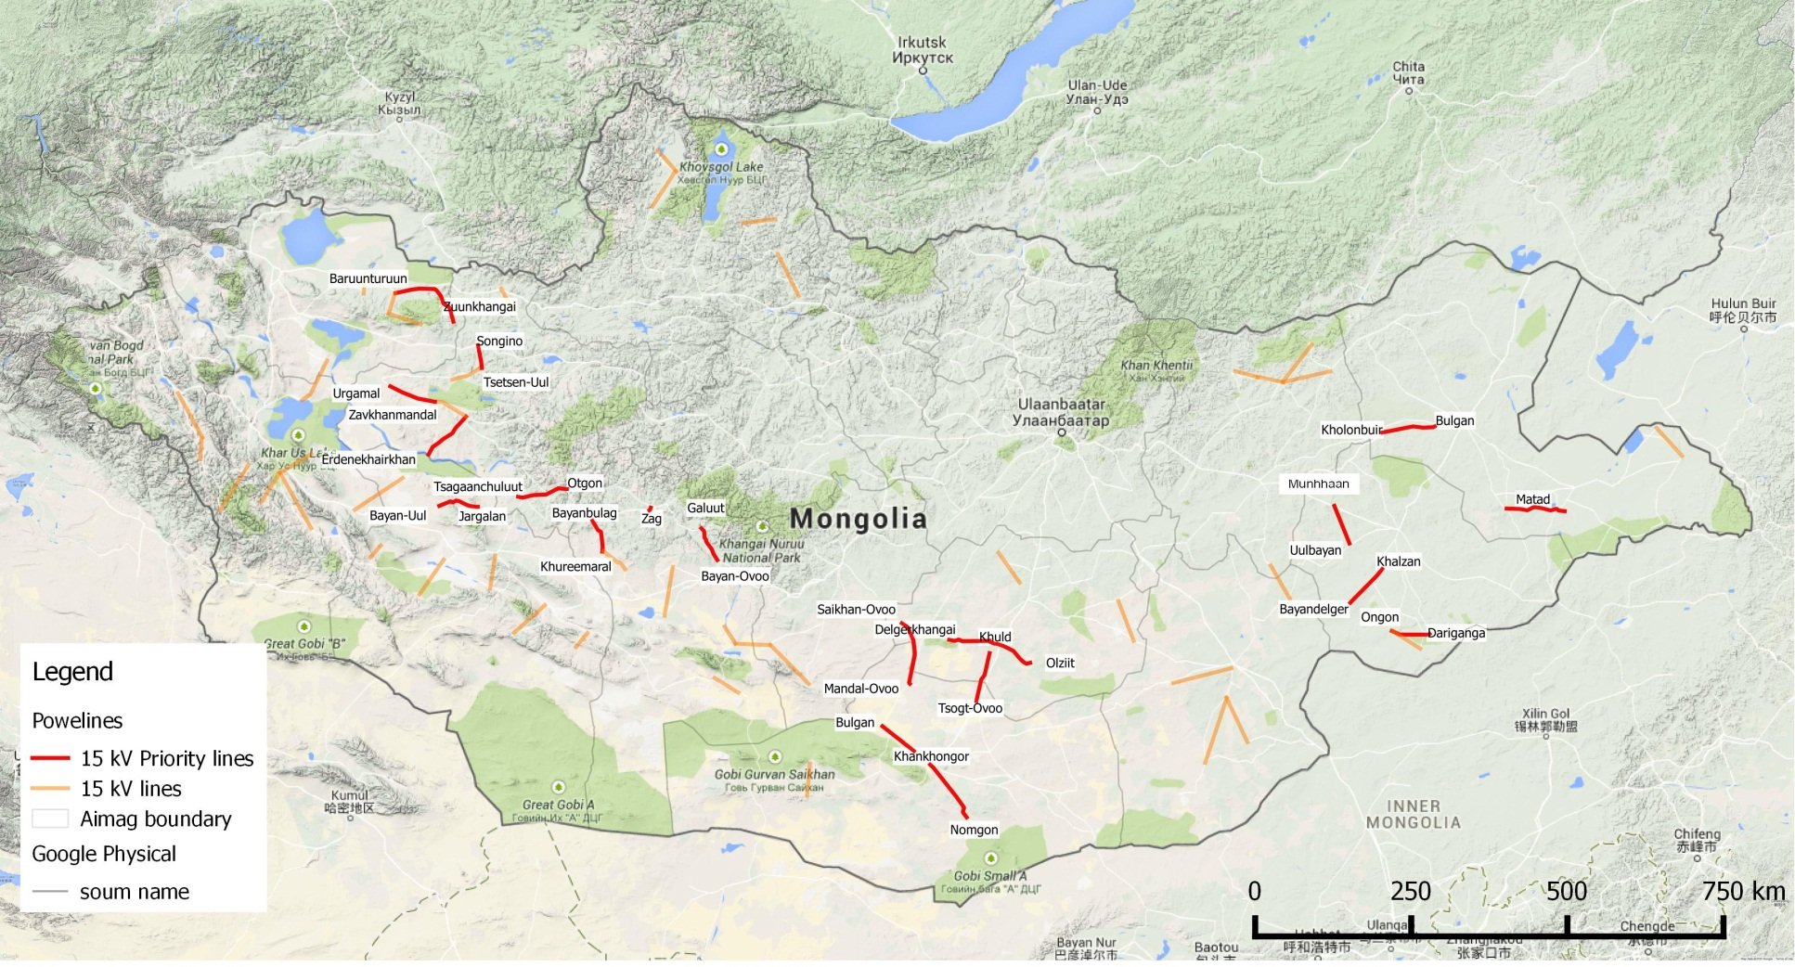
Mongolian dangerous power lines

Slide 12
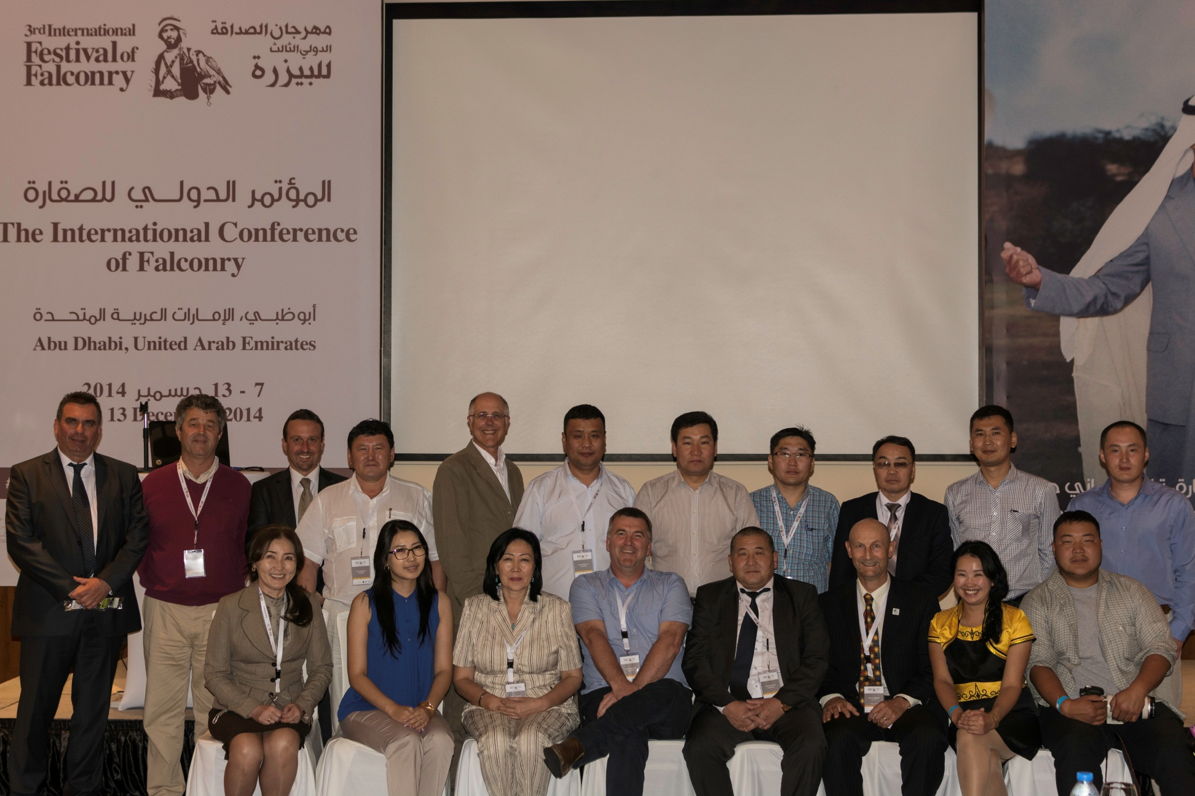
Preventing raptor electrocution
In Mongolia, scientists are working with power companies to solve this problem

Slide 13
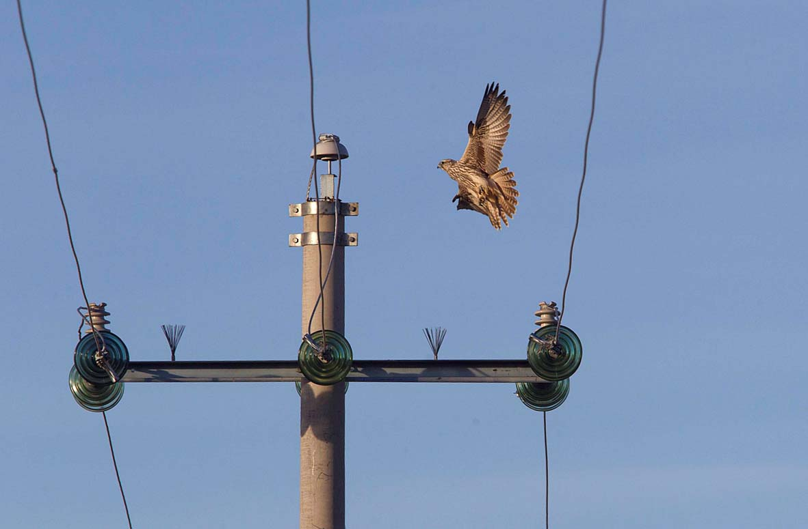
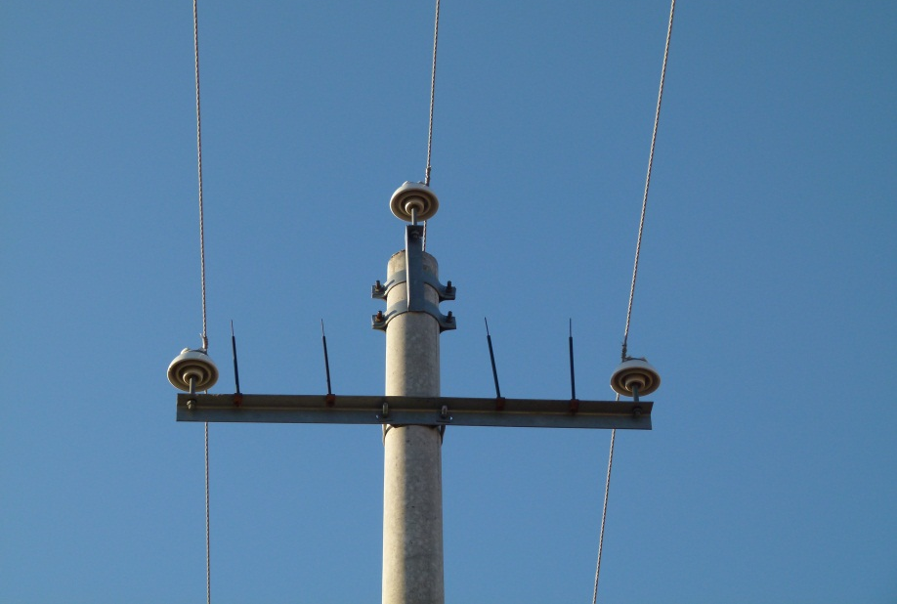
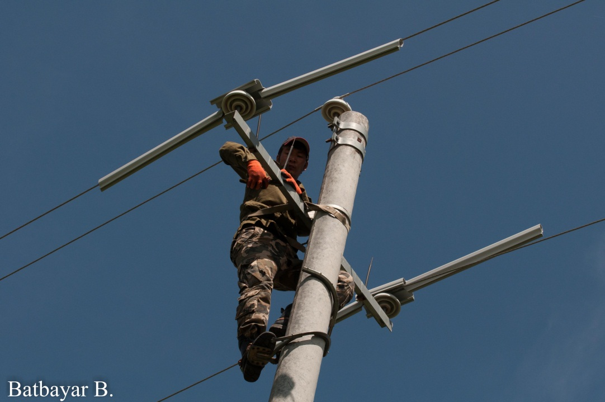
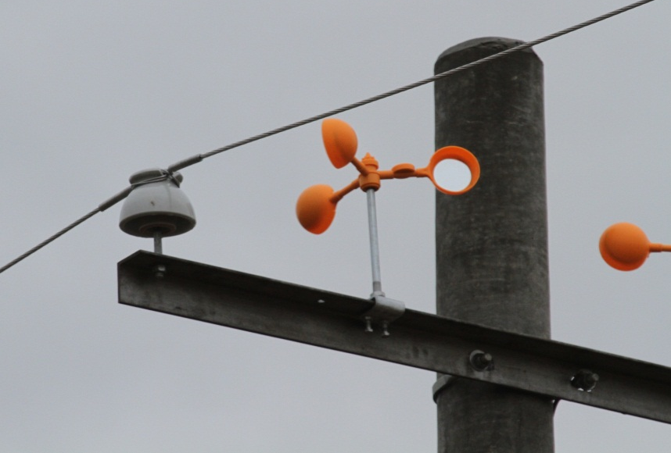
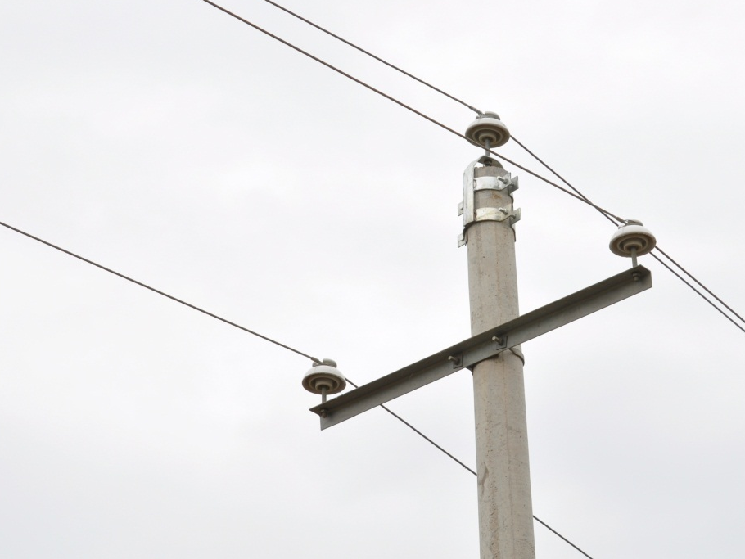
Preventing raptor electrocution
Spikes , brushes and rotating mirrors were installed on cross arm
Plastic covers put on live wires
Changing pin insulator mounts to prevent raptors perching on pole
To try and prevent raptors perching on the cross arm
Spikes were fitted
Brushes were fitted
Rotating mirrors attached
Scientists found that spikes are the best

Slide 14
Preventing raptor electrocution
Plastic covers were put over electric cables to prevent raptors touching the live wires
This method is very expensive
Changing pin insulator mounts can prevent raptors perching on pole

Slide 15
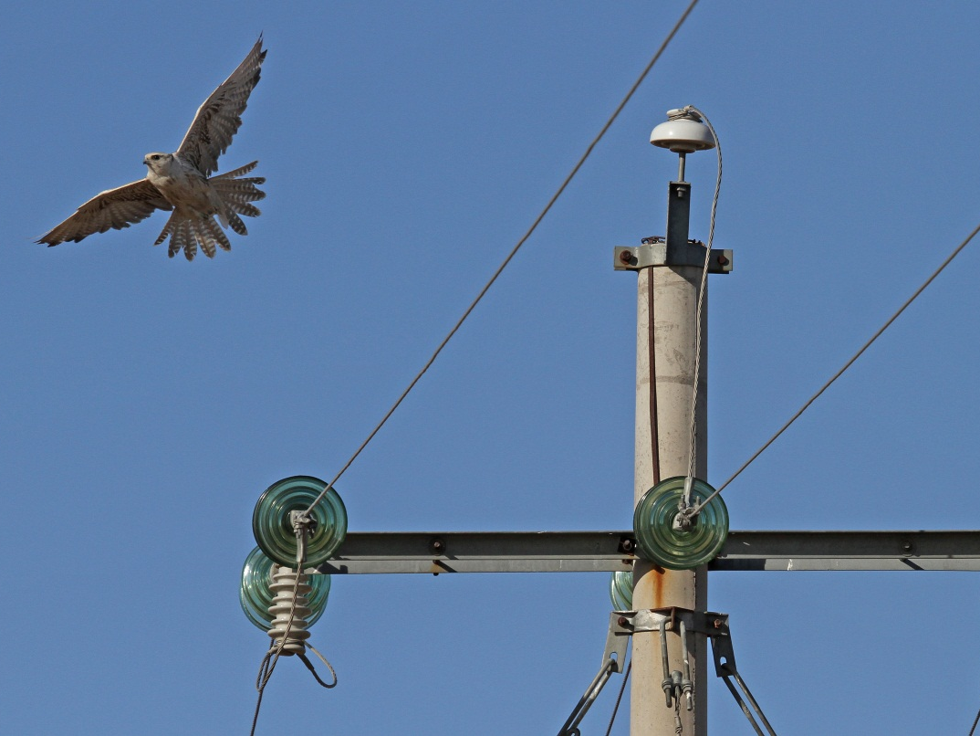
Mitigation can prevent bird death or reduce the number of Saker Falcons killed on power lines
One of the biggest problems in Mongolia for Saker falcons is electrocution. Every year 4000 Saker falcons are electrocuted on power lines

Slide 16
What next ? Complete the Student Worksheet on Raptor Electrocution Try out the Raptor Electrocution student activity game
Written by Nicola Dixon, Mohamed bin Zayed Falconry & Desert Physiognomy School

